Slide 1


Consumer goods Ad_Hoc Insights
Sql resume challenge 4

Slide 2
About company
Atliq Hardwares is one of the leading computer hardware producers in India and well expanded in other countries too.
However, the management noticed that they do not get enough insights to make quick and smart data-informed decisions.
They want to expand their data analytics team by adding several junior data analysts.
Tony Sharma, their data analytics director wanted to hire someone who is good at both tech and soft skills. Hence, he decided to conduct a SQL challenge which will help him understand both the skills.

Slide 3
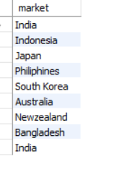
Atliq Exclusive across all the markets in APAC region
Question
Provide the list of markets in which customer "Atliq Exclusive" operates its business in the APAC region.
Output:

Slide 4
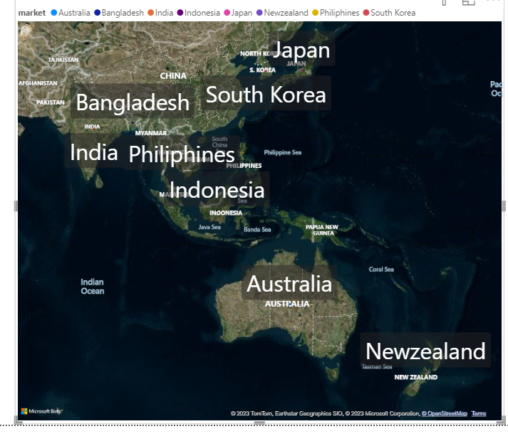
Conversion of output into visual
Insights
In APAC region our Atliq exclusive store has established its presence in 8 major markets

Slide 5

unique product increase in 2021 vs. 2020
Question
What is the percentage of unique product increase in 2021 vs. 2020? The final output contains these fields,
unique_products_2020
unique_products_2021
percentage_chg
Output:

Slide 6
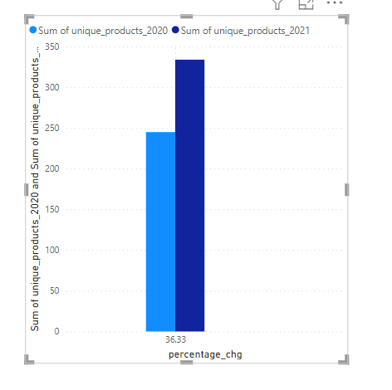
Conversion of output into visual
Insights
The 36% increase in unique products from 2020 - 245 to 2021- 334 is a positive sign, signaling not only business growth but also a proactive response to market demands and a commitment to innovation.

Slide 7
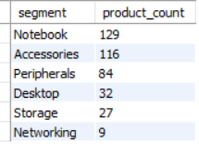
unique product count for each segment
Question
Provide a report with all the unique product counts for each segment and sort them in descending order of product counts. The final output contains 2 fields,
segment
product_count
Output:

Slide 8
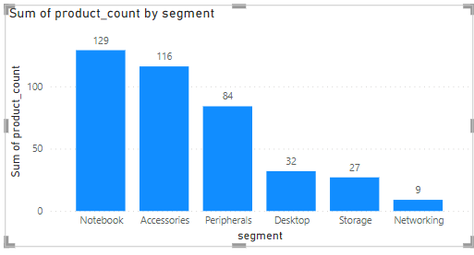
Conversion of output into visual
Insights
From the visual we can observe that the top 3 products count by segment are notebook, Accessories, peripherals with an average of 110 products each segment.
But we need focus on desktop, storage, networking segment product counts as they were just average of 23 products per segment

Slide 9
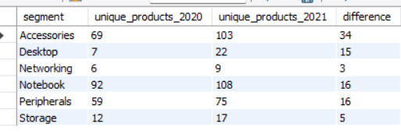
Which segment has highest increase in unique products in 2021 vs 2020?
Question
Follow-up: Which segment had the most increase in unique products in 2021 vs 2020? The final output contains these fields,
segment
product_count_2020
product_count_2021
difference
Output:

Slide 10
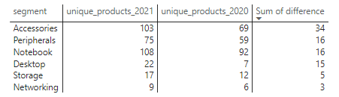
Conversion of output into visual
Insights
Accessories had the largest increase of production growth.
But storage and Networking segments are experiencing slower production growth

Slide 11

Question: Get the products that have the highest and lowest manufacturing costs. The final output should contain these fields,
product_code,
product,
manufacturing_cost
Insights
AQ Home Allin 1 Gen 2 has the higest manufracturing cost
AQ Masterwiredx1Mshas lowest manufracturing cost

Slide 12
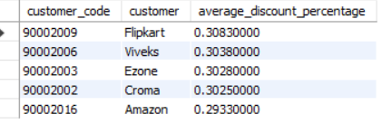
top 5 customers who received an average high pre_invoice_discount_pct for the fiscal year 2021 and in the Indian market.
Question
Generate a report which contains the top 5 customers who received an average high pre_invoice_discount_pct for the fiscal year 2021 and in the Indian market. The final output contains these fields,
customer_code
customer
average_discount_percentage
Output:

Slide 13
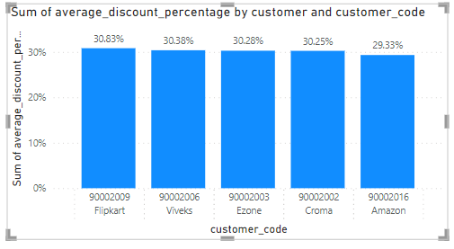
Conversion of output into visual
Insights
In top 5 average pre invoice discounts.
We are providing more discounts to Flipkart.
In top 5 lowest average discount goes to Amazon.

Slide 14
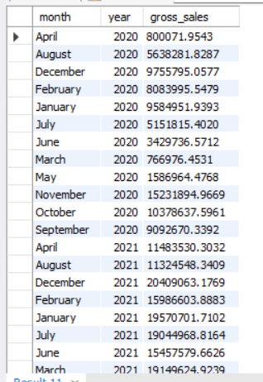
Monthly wise gross sales amount for customer Atliq Exclusive
Question
Get the complete report of the Gross sales amount for the customer “Atliq Exclusive” for each month. This analysis helps to get an idea of low and high-performing months and take strategic decisions.
The final report contains these columns:
Month
Year
Gross sales Amount
Output:

Slide 15
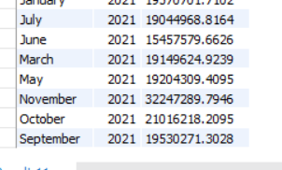
Insights
Our fiscal year starts from September to august so 2020 sep in records = 2019 sep.
The table shows monthly wise gross price.
In Fiscal year 2020 we have total sales 79.50 M
In fiscal year 2021 we have total sales 224.42 M

Slide 16
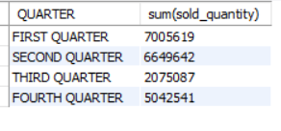
Highest sold quality quarterly wise
Question
In which quarter of 2020, got the maximum total_sold_quantity? The final output contains these fields sorted by the total_sold_quantity,
Quarter,
total_sold_quantity
Output:

Slide 17
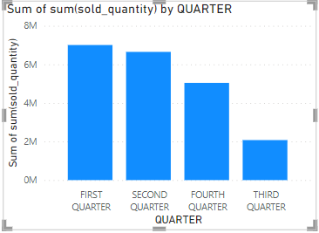
Conversion of output into visual
Insights
According to our fiscal year Q1 – sep to nov
first quarter has highest sold quality for fiscal year 2020.
Third quarter has lowest sold quality that is March to May 2020.
The reasons can be : covid-19, Global Chip Shortage

Slide 18

Highest gross sales price and percentage for channels in fiscal year 2021
Question
Which channel helped to bring more gross sales in the fiscal year 2021 and the percentage of contribution? The final output contains these fields,
Channel,
gross_sales_mln,
percentage
Output:

Slide 19
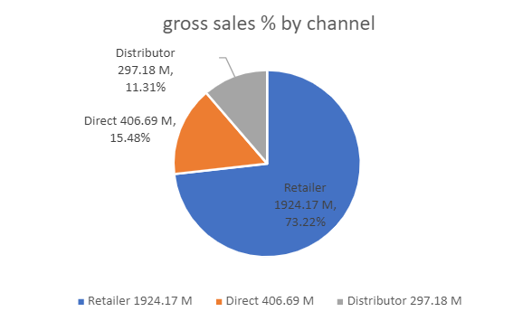
Conversion of output into visual
Insights
Majority of our sales took place via retailers, which is 75% of total sales
Least sales were via distributor

Slide 20
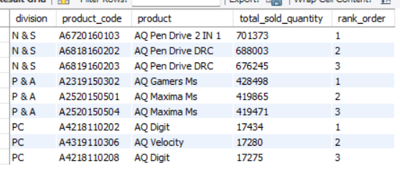
Top 3 products in each division for fiscal year 2021
Question
Get the Top 3 products in each division that have a high total_sold_quantity in the fiscal_year 2021? The final output contains these fields,
Division,
product_code,
Product,
total_sold_quantity,
rank_order
Insights:
Every division has a product with different variants that appears twice in the top three products by division list

Slide 21

Thank You

